Slide 1

Image processing and Neural Networks
Track module 2
Ekaterina Golubeva
21.06.2023

Slide 2

Milestones of Track module 2
Introduction to Neural Networks
Data augmentation
Transfer learning and pretrained models
Tensorboard, experiments, comparison of models
Hyperparameters tuning: batch size, learning rate, lr scheduler
Introduction to Visual Transformers
Introduction to Hyperparameters Optimization and Neural Architecture search

Slide 3
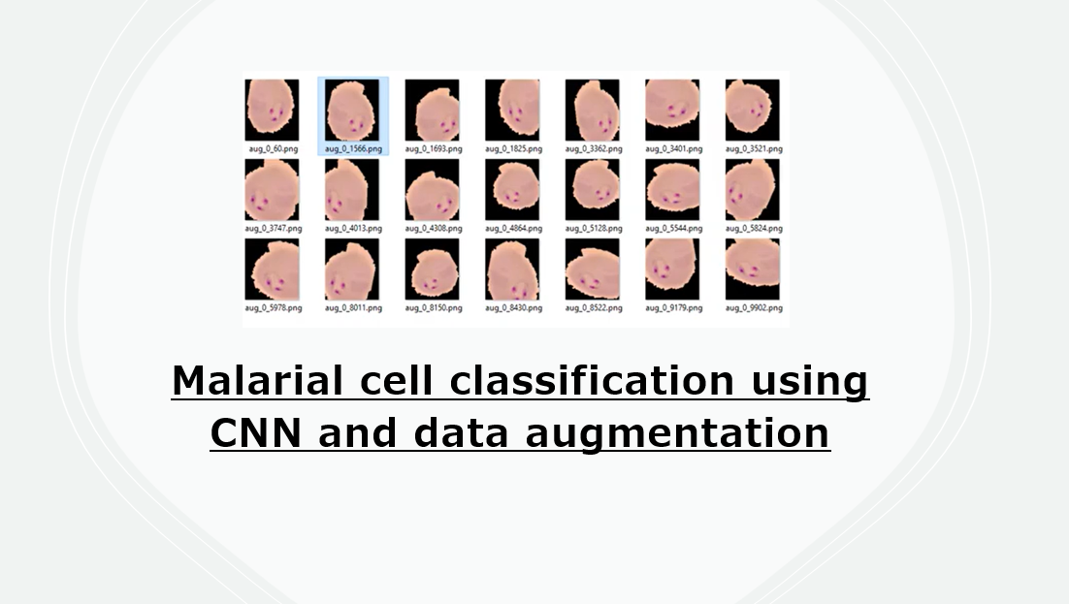
Recall : Neural Networks and Deep learning

Slide 4
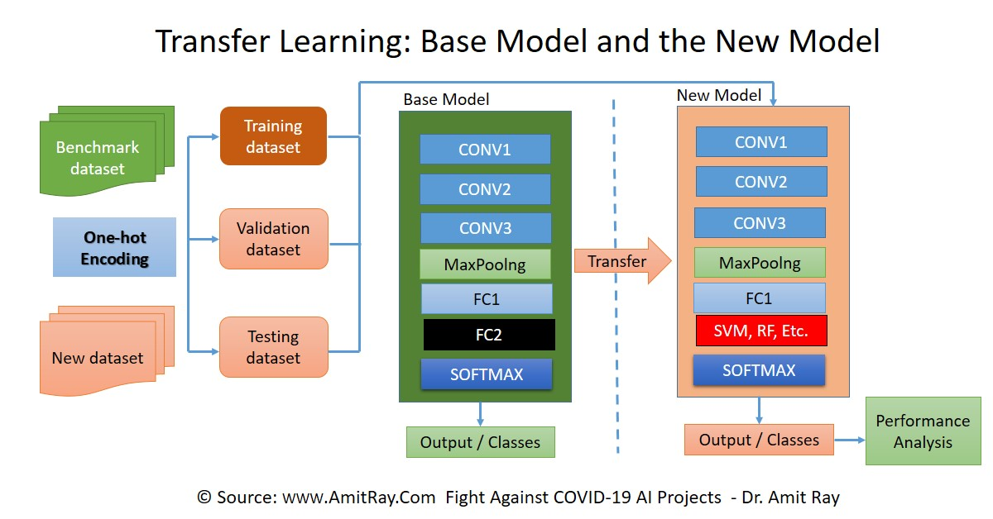
Two major transfer learning scenarios
Finetuning the CNN
Instead of random initialization, we initialize the network with a pretrained network, like the one that is trained on ImagenNet 1000 dataset. Rest of the training looks as usual.
CNN as fixed feature extractor
Here, we will freeze the weights for all of the network except that of the final fully connected layer. This last fully connected layer is replaced with a new one with random weights and only this layer is trained.

Slide 5
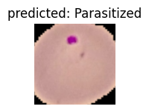
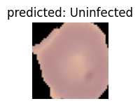
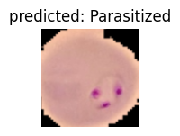
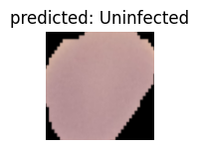
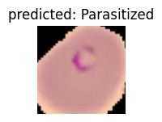
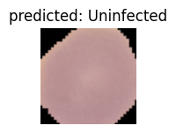
CNN as fixed feature extractor applied to the Malarial cells problem
Model : ResNet18
Batch size : 32
Epochs : 15
Learning rate : 0.01
Training complete in 6m 21s
Best val Acc: 0.900000

Slide 6
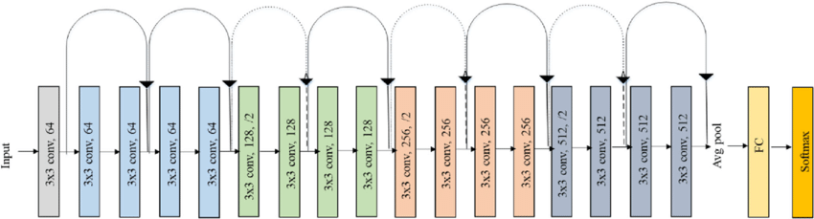
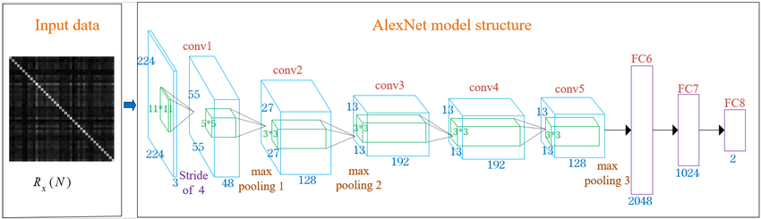

ResNet AlexNet VGG16

Slide 7

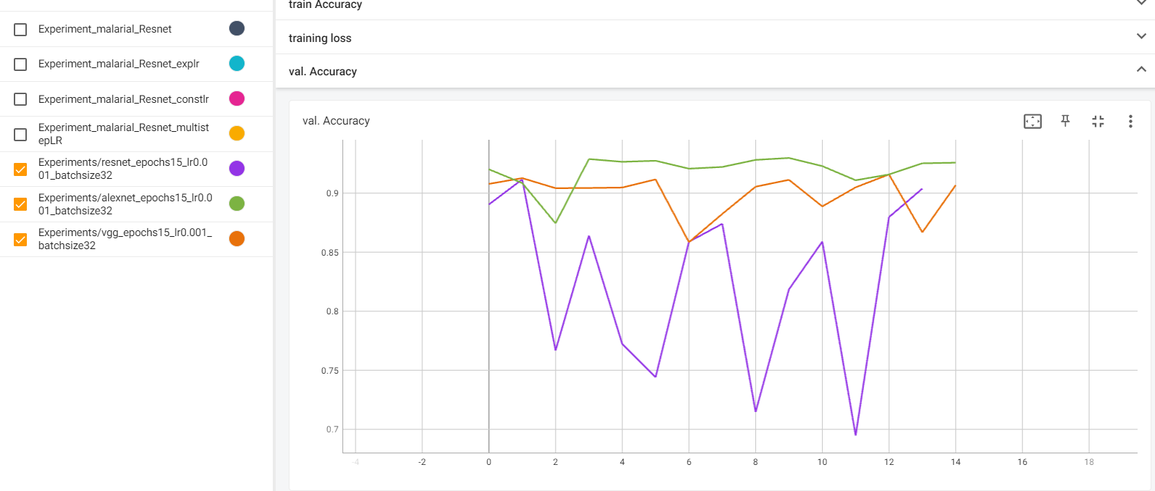
Visualizing images and running experiments

Slide 8
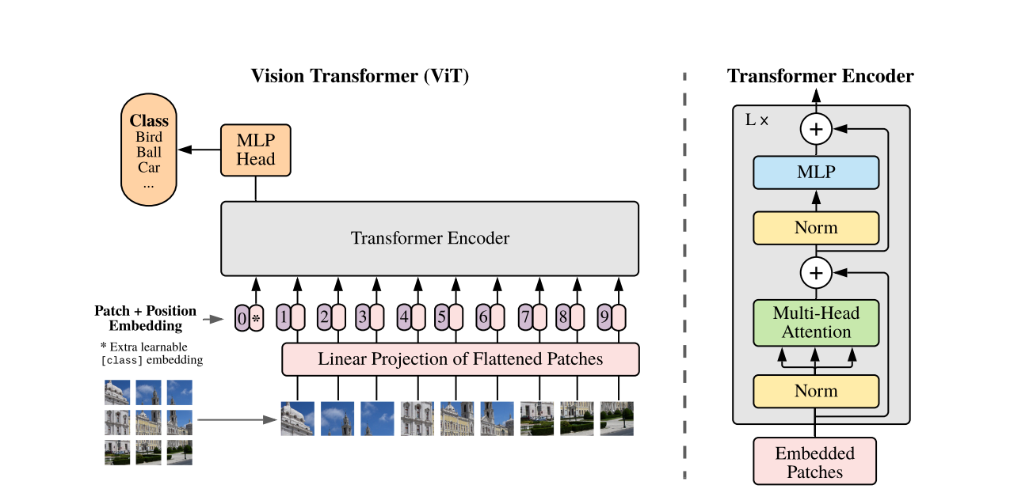
Introduction to more complex architectures

Slide 9


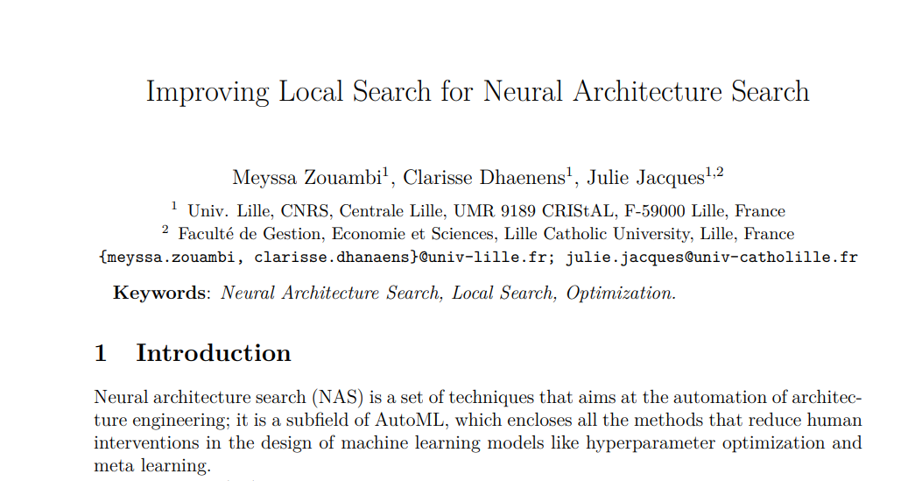

Slide 10
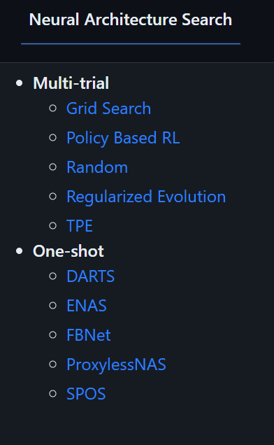
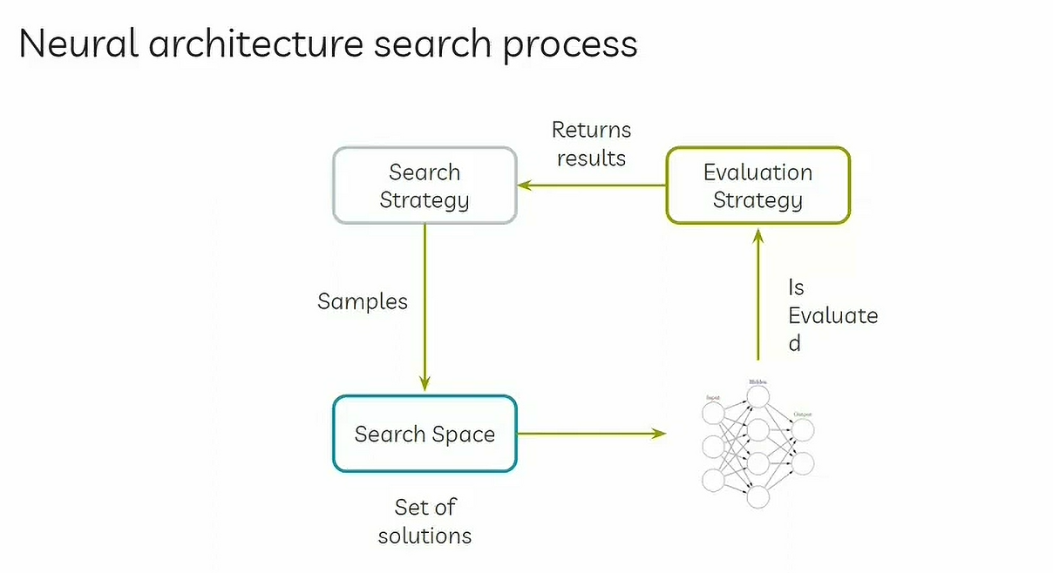

Slide 11
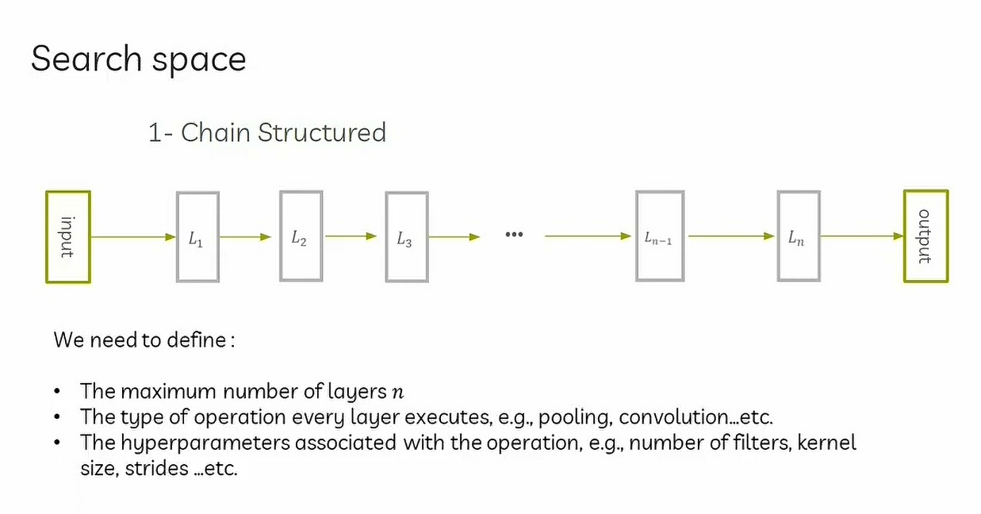

Slide 12
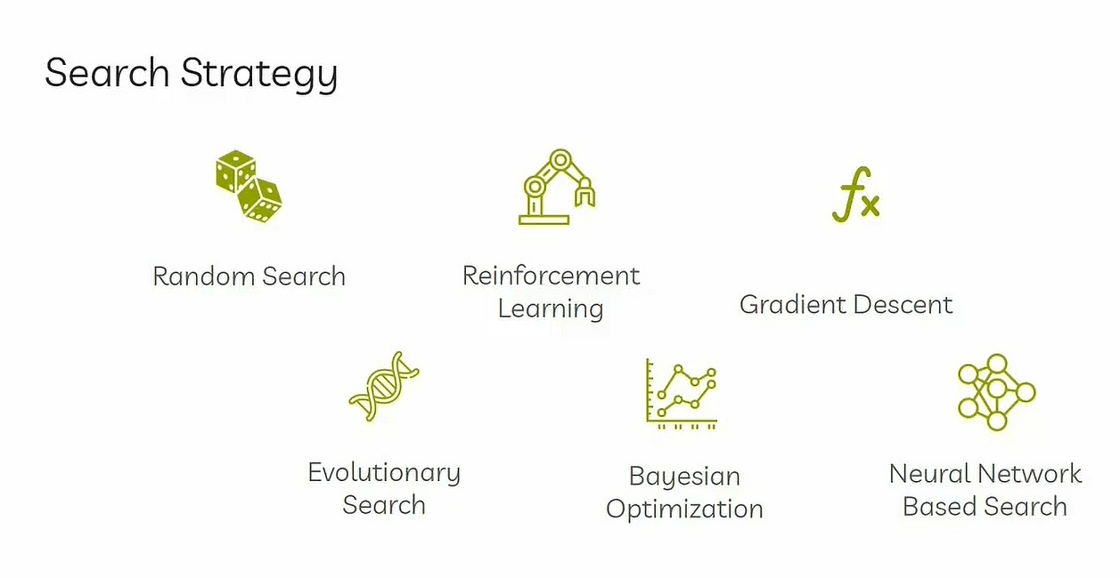

Slide 13
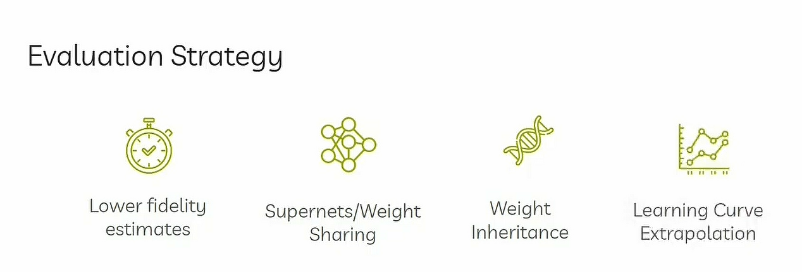

Slide 14
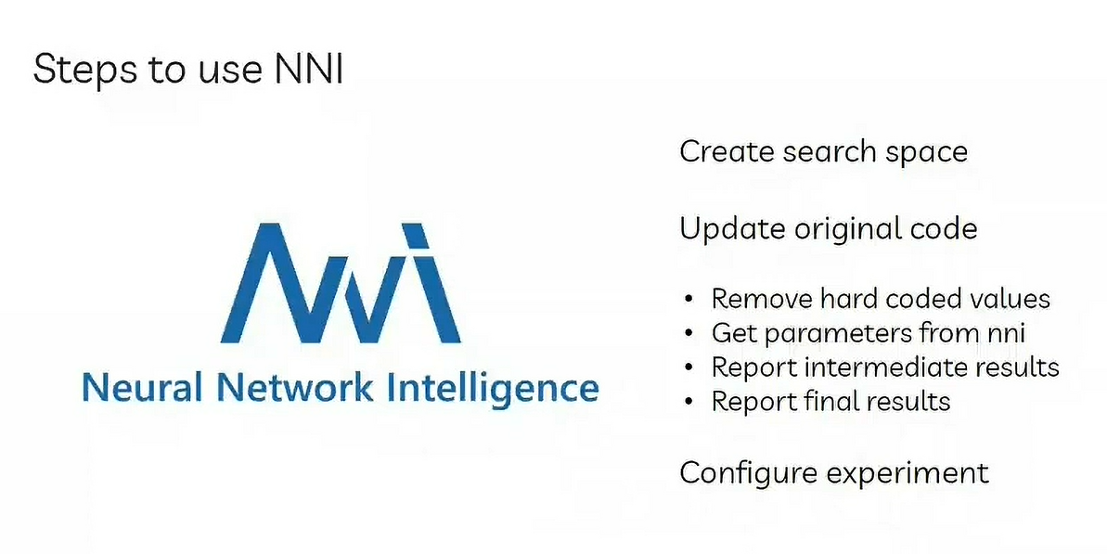

Slide 15
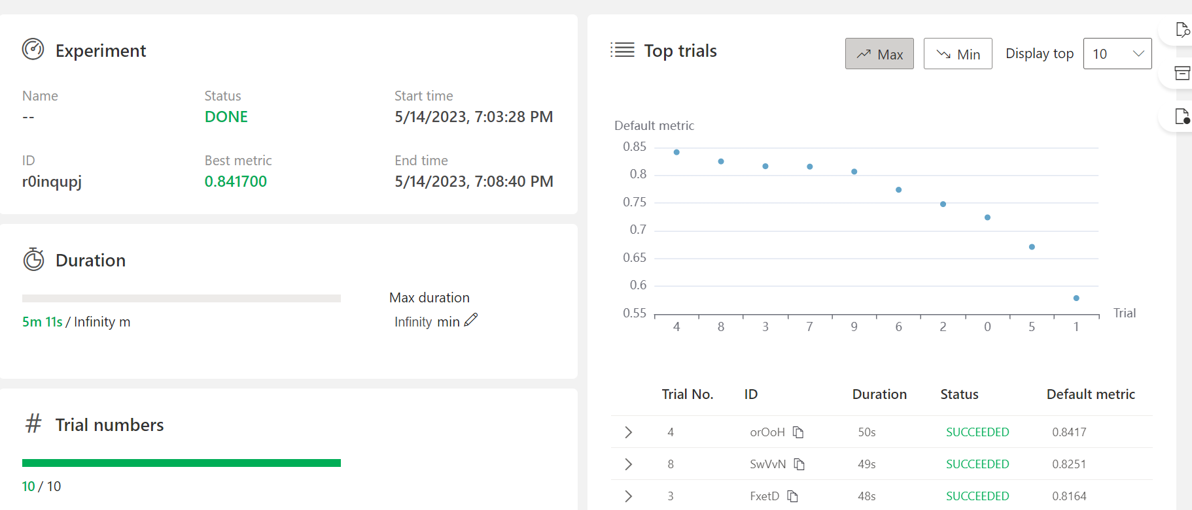
NNI interactive web portal

Slide 16
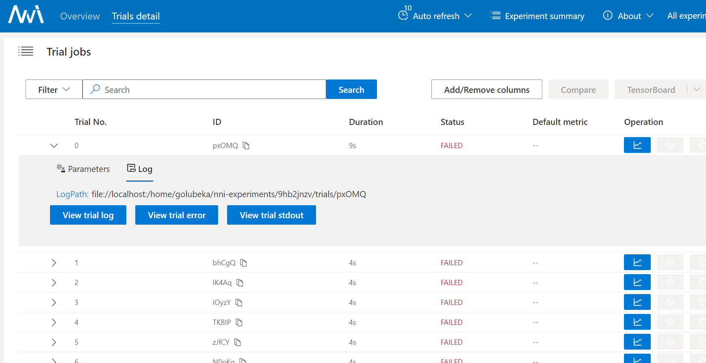
NNI webserver debugging
Error messages from nni

Slide 17
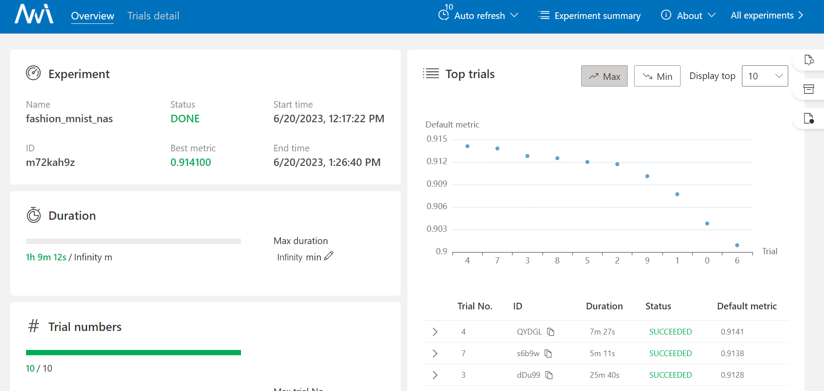
Fashion MNIST Nas experiment

Slide 18
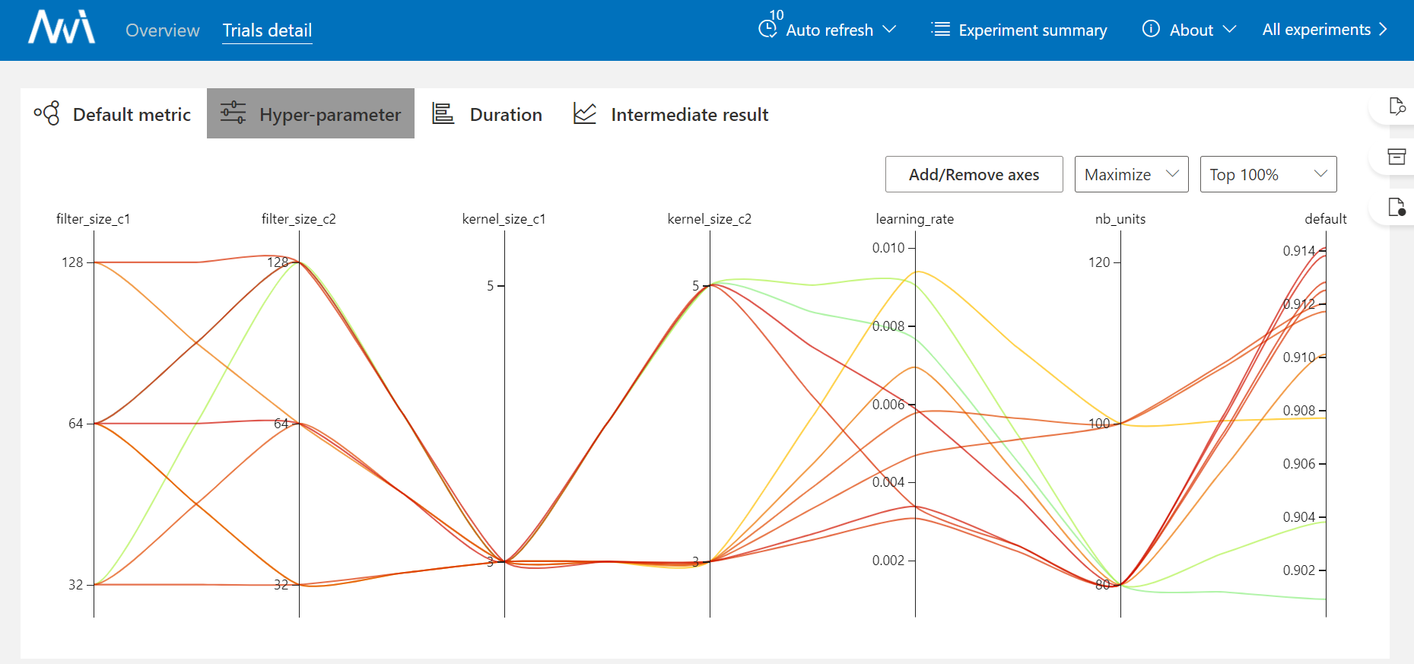

Slide 19
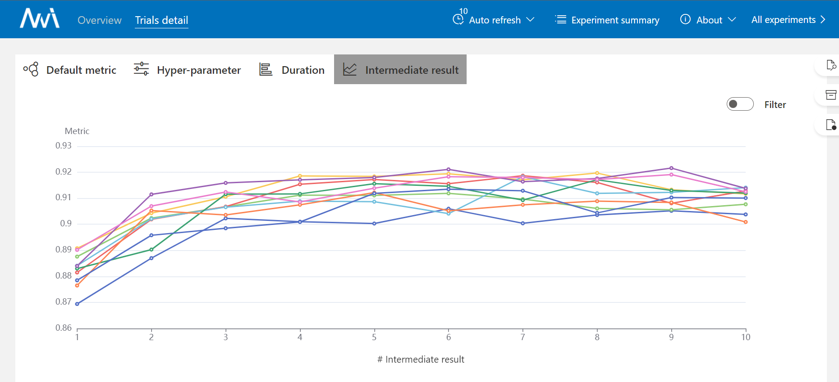
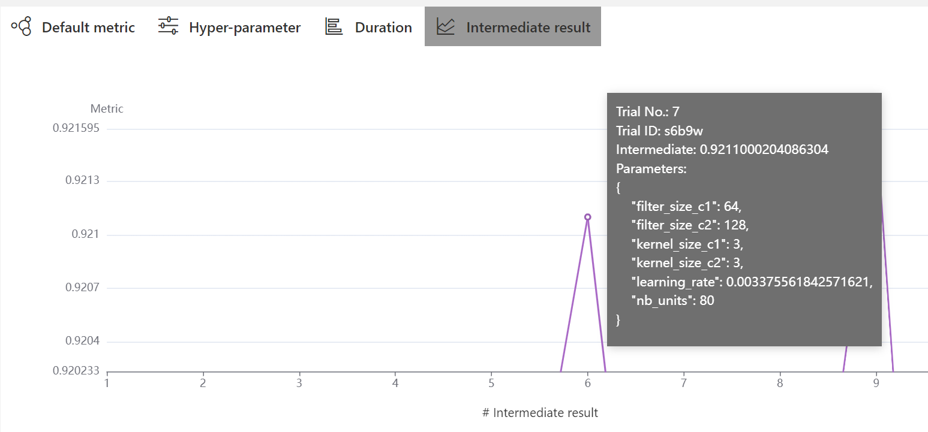

Slide 20
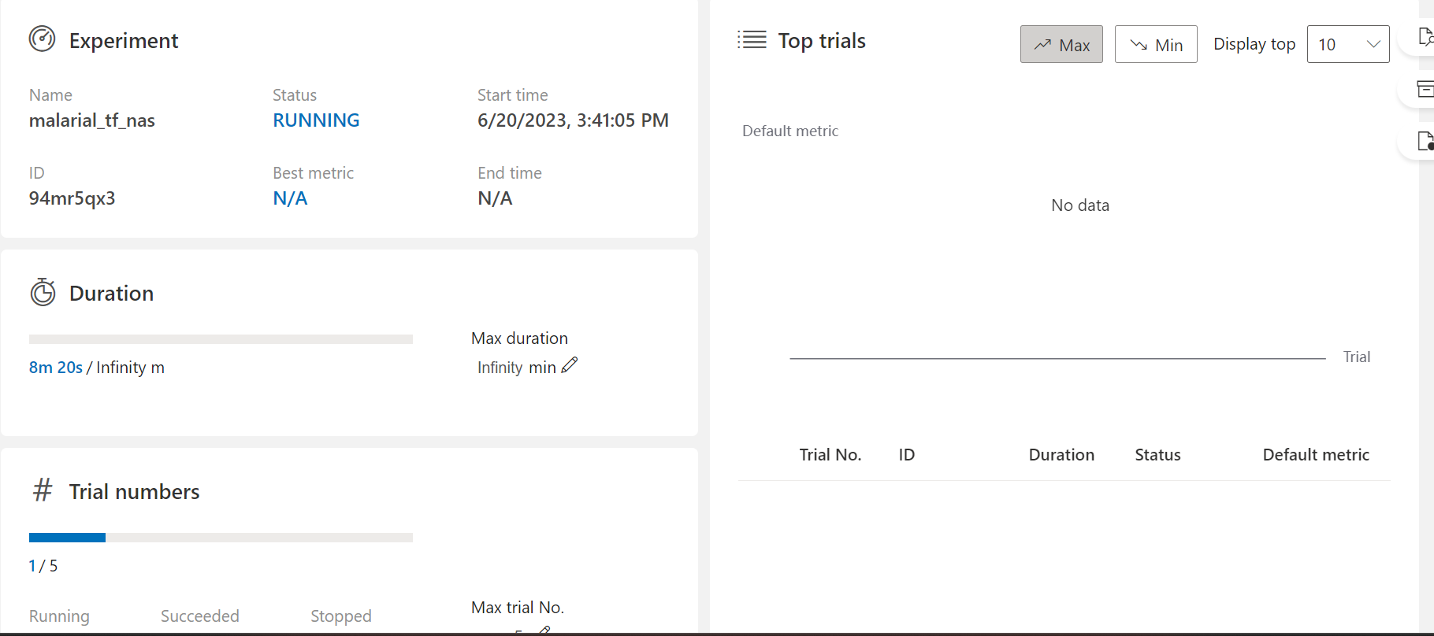
Applied to malarial dataset

Slide 21

Neural Architecture Search
Advantages
Automation: NAS automates the process of neural network design, saving time and effort for researchers and practitioners.
Performance Improvement: NAS can discover architectures that outperform manually designed ones, achieving state-of-the-art results.
Domain-Specific Architectures: NAS can generate architectures tailored to specific domains, optimizing performance for specific tasks.
Limitations
Computational Cost: NAS often requires substantial computational resources, such as GPUs or even specialized hardware, due to the extensive search space and training of numerous candidate architectures.
Search Space Constraints: NAS is constrained by the predefined search space, which limits the variety of architectures it can explore.
Lack of Interpretability: Generated architectures may lack interpretability, making it challenging to understand the underlying mechanisms.

Slide 22

Next steps Plans for the summer
Fix TF GPU or translate to PyTorch
Applied Reinforcement learning course
Internship at KAS (?)
Create a plan for the Master thesis
Get comfortable with running NAS experiments
HPO tutorials
Set up a Visual Transformer model

Slide 23

Organization
Master thesis topic (Plan A)
First draft : Application of a pretrained ViT on blood cell dataset classification problem and comparison with simpler approaches
Master thesis internship topic (Plan B)
First draft: Computer vision, denoising of CT brain scans, automation of brain tumors segmentation
Meeting with Dr Felice Burn and visiting KAS

